Slide 1
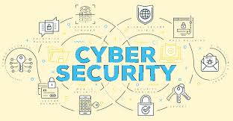
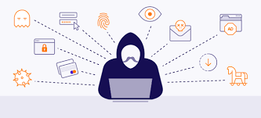
CA 501 : CYBER SECURITY
Chapter 2 : Cyber offenses and Cyber Stalking

Slide 2

Let’s Start
Topics:
2.1 Criminals Plan: Categories of Cybercrime Cyber Attacks: Reconnaissance, Passive Attack, Active Attacks, Scanning/Scrutinizing gathered Information, Attack (Gaining and Maintaining the System Access), Social Engineering, and Classification of Social Engineering.
2.2 Cyber stalking: Types of Stalkers, Cases Reported on Cyber stalking, Working of Stalking
2.3 Real-Life Incident of Cyber stalking
2.4 Cyber cafe and Cybercrimes
2.5 Botnets: The Fuel for Cybercrime, Botnet, Attack Vector
2.6 Cybercrime: Mobile and Wireless Devices – Proliferation - Trends in Mobility
2.7 Credit Card Frauds in Mobile and Wireless Computing Era
2.8 Security Challenges Posed by Mobile Devices
2.9 Authentication Service Security
2.10 Attacks on Mobile/Cell Phones

Slide 3
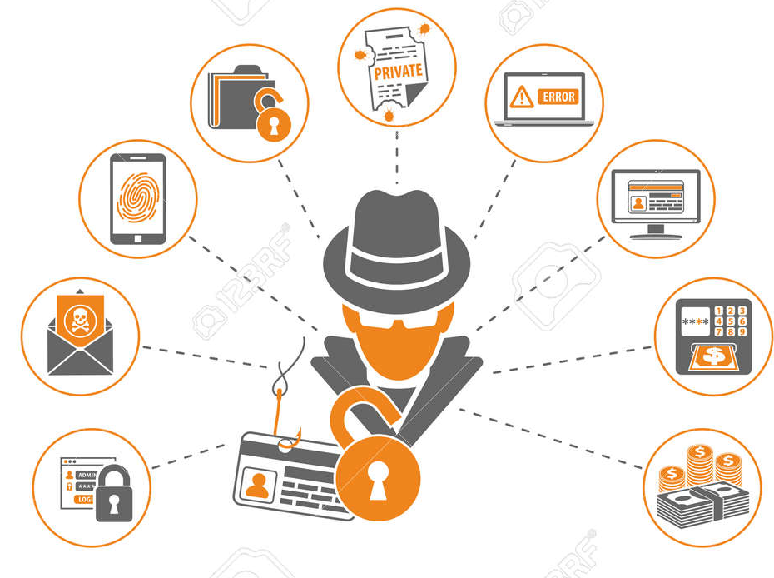
Cyber Attacks
- A cyber-attack is where an attacker tries to gain unauthorized access to an IT system for the purpose of theft, extortion, disruption or other reasons.
- A cyber-attack is any offensive scheme that targets computer information systems, computer networks, infrastructures, or personal computer devices. An attacker is a person or process that attempts to access data, functions, or other restricted areas of the system without authorization, potentially with malicious intent.
- Depending on the context, cyber-attacks can be part of cyber warfare or cyber terrorism. A cyber-attack can be employed by sovereign states, individuals, groups, society, or organizations, and it may originate from
an anonymous source. A product that facilitates a
cyber-attack is sometimes called a cyber-weapon.

Slide 4
Cyber Attacks
- A cyber-attack may steal, alter, or destroy a specified target by hacking into a susceptible system. Cyber-attacks can range from installing spyware on a personal computer to attempting to destroy the infrastructure of entire nations. Cyber-attacks have become increasingly sophisticated and dangerous.
Cyber-attacks occur in 2 forms:
1. An attack in the Web
These types of attacks are launched into the web application.
2. An attack in the System
These attacks target a particular node (computer in a network) and try to exploit it.

Slide 5
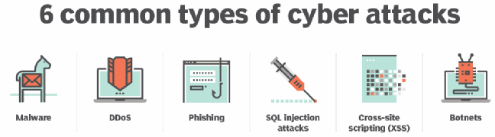
Cyber Attacks
- Categories Cyber Attacks:

Slide 6
Cyber Attacks
Few Cases of Cyber Attacks:
- The massive SolarWinds attack, detected in December 2020, breached U.S. federal agencies, infrastructure and private corporations in what is believed to be among the worst cyber espionage attacks inflicted on the U.S. On Dec. 13, 2020, it was revealed that Austin-based IT management Software Company SolarWinds was hit by a supply chain attack that compromised updates for its Orion software platform. As part of this attack, threat actors inserted their own malware, now known as Sunburst or Solorigate, into the updates, which were distributed to many SolarWinds customers.
- A July 2020 attack on Twitter, in which hackers were able to access the Twitter accounts of high-profile users.
- The May 2017 WannaCry ransomware attack, which hit more than 300,000 computers across various industries in 150 nations, causing billions of dollars of damage.

Slide 7
Cyber Attacks
Few Cases of Cyber Attacks:
- Another 2016 attack, this time at FriendFinder, which said more than 20 years' worth of data belonging to 412 million users was compromised.
- A data breach at Yahoo in 2016 that exposed personal information contained within 500 million user accounts, which was then followed by news of another attack that compromised 1 billion user accounts;

Slide 8
Cyber Attacks
Criminal Plan/ Stages of Cyber – Attack:
If you want to prevent a hack, you have to know how a hacker thinks, plans, and executes. Understanding what tactics hackers use and what information they find most valuable is useful to prioritize cyber security investment and effort.
Criminals use many methods and tools to locate the vulnerabilities of their target. The target can be an individual and/or an organization.
The following phases are involved in planning cybercrime:
1. Reconnaissance (information gathering)
2. Type of attack – active/ passive
3. Scanning and scrutinizing the gathered information for the validity of the information as well as to identify the existing vulnerabilities.
4. Launching an attack (gaining and maintaining the system access).

Slide 9
Cyber Attacks
1. Reconnaissance:
- Reconnaissance is a preliminary survey often with the goal to find or to gain information (especially to gain information about an enemy or potential enemy).
- In the world of "hacking," reconnaissance phase begins with "Foot printing". Research and reconnaissance are known as foot printing, is a preparatory phase where the hacker begins researching their target to obtain as much information as possible.
- This is the preparation toward pre attack phase, and involves accumulating data about the target's environment and computer architecture to find ways to intrude into that environment. Foot printing gives an overview about system vulnerabilities and provides a judgment about possible exploitation of those vulnerabilities.
- The objective of this preparatory phase is to understand the system, its networking ports and services, and any other aspects of its security that are needful for launching the attack.

Slide 10
Cyber Attacks
2. Type of attack – active/ passive:
An attacker attempts to gather information in two phases: passive and active attacks.
a) Passive Attacks:
A passive attack involves gathering information about a target without his/her (individual's or company's) knowledge. It can be as simple as watching a building to identify what time employees enter the building's premises. However, it is usually done using Internet searches or by Googling (i,e., searching the required information with the help of search engine Google) an individual or company to gain information.
1. Google or Yahoo search: People search to locate information about employees.
2. Surfing online community groups like Orkut/Facebook will prove useful to gain the information about an individual.

Slide 11
Cyber Attacks
a) Passive Attacks:
3. Organization's website may provide a personnel directory or information about key employees, for example, contact details, E-Mail address, etc. These can be used in a social engineering attack to reach the target.
4. Blogs, newsgroups, press releases, etc. are generally used as the mediums to gain information about the company or employees.
5. Going through the job postings in particular job profiles for technical persons can provide information about type of technology, that is, servers or infrastructure devices a company maybe using on its network.

Slide 12
Cyber Attacks
b) Active Attacks:
An active attack involves probing the network to discover individual hosts to confirm the information (IP addresses, operating system type and version, and services on the network) gathered in the passive attack, phase. It involves the risk of detection and is also called "Rattling the doorknobs" or "Active reconnaissance."
Active reconnaissance can provide confirmation to an attacker about security measures in place, but the process can also increase the chance of being caught or raise suspicion.

Slide 13
Cyber Attacks
3. Scanning and Scrutinizing Gathered Information:
Scanning is a key step to examine intelligently while gathering information about the target. The objectives of scanning are as follows:
1. Port scanning: Identify open/close ports and services.
2. Network scanning: Understand IP Addresses and related information about the computer network systems.
3. Vulnerability scanning: Understand the existing weaknesses in the system.
The scrutinizing phase is always called "enumeration" in the hacking world. The objective behind this step is to identify:
1. The valid user accounts or groups;
2. Network resources and/or shared resources
3. OS and different applications that are running on the OS.

Slide 14
Cyber Attacks
4. Launching an Attack:
Entry points into a network can vary. Possible weak points include employees who fall for a phishing email by clicking on the attachment and downloading malware. Other vulnerabilities include when employees are convinced to share relevant data like login credentials or one of your systems was not configured or patched properly and the attacker used known vulnerabilities to circumvent your company’s defenses.
After the scanning and enumeration, the attack is launched using the following steps:
1. Crack the password
2. Exploit he password
3. Execute the malicious command/applications;
4. Hide the files (if required);
5. Cover the tracks - delete the access logs, so that there is no trail illicit activity.

Slide 15
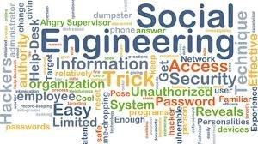
Cyber Attacks
Social Engineering:
In the context of information security, social engineering is the psychological manipulation of people into performing actions or divulging confidential information.
It is a type of confidence trick for the purpose of information gathering, fraud, or system access.
It has also been defined as "any act that influences a person to take an action that may or may not be in their best interests."
Social engineering is the term used for a broad range of malicious activities accomplished through human interactions. It uses psychological manipulation to trick users into making security mistakes or giving away sensitive information.

Slide 16
Cyber Attacks
Social Engineering:
Social engineering attacks happen in one or more steps. A perpetrator first investigates the intended victim to gather necessary background information, such as potential points of entry and weak security protocols, needed to proceed with the attack.
Then, the attacker moves to gain the victim’s trust and provide stimuli for subsequent actions that break security practices, such as revealing sensitive information or granting access to critical resources.
An example of social engineering is the use of the "forgot password" function on most websites which require login. An improperly-secured password-recovery system can be used to grant a malicious attacker full access to a user's account, while the original user will lose access to the account.

Slide 17
Cyber Attacks
Social Engineering:
Generally, social engineering attackers have one of two goals:
Sabotage: Disrupting or corrupting data to cause harm or inconvenience.
Theft: Obtaining valuables like information, access, or money.
Most social engineering attacks rely on actual communication between attackers and victims. The attacker tends to motivate the user into compromising themselves, rather than using brute force methods to breach your data.
A brute force attack uses trial-and-error to guess login info, encryption keys, or find a hidden web page. Hackers work through all possible combinations hoping to guess correctly.
These attacks are done by ‘brute force’ meaning they use excessive forceful attempts to try and ‘force’ their way into your private account(s).

Slide 18
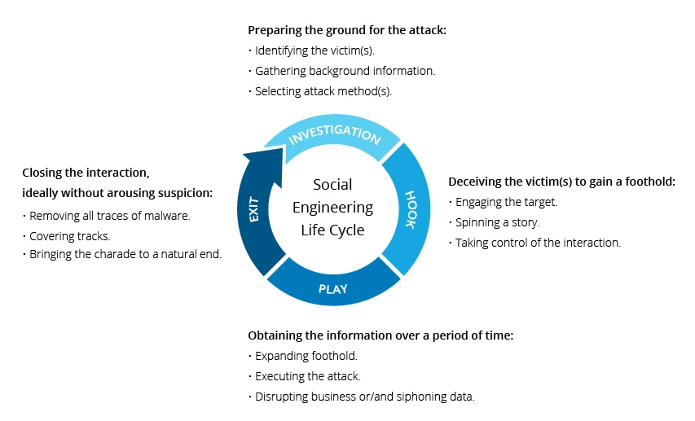
Cyber Attacks
Social Engineering Attack Life Cycle:
What makes social engineering especially dangerous is that it relies on human error, rather than vulnerabilities in software and operating systems. Mistakes made by legitimate users are much less predictable, making them harder to identify and prevent than a malware-based intrusion.

Slide 19
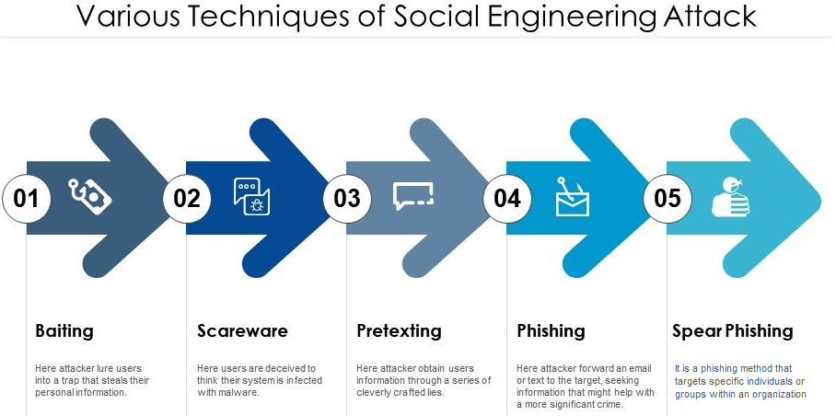
Cyber Attacks
Social Engineering:

Slide 20
Cyber Attacks
Social Engineering Cases:
1. $100 Million Google and Facebook Spear Phishing Scam:
The biggest social engineering attack of all time (as far as we know) was perpetrated by Lithuanian national Evaldas Rimasauskas against two of the world’s biggest companies: Google and Facebook.
Rimasauskas and his team set up a fake company, pretending to be a computer manufacturer that worked with Google and Facebook. Rimsauskas also set up bank accounts in the company’s name.
The scammers then sent phishing emails to specific Google and Facebook employees, invoicing them for goods and services that the manufacturer had genuinely provided — but directing them to deposit money into their fraudulent accounts.
Between 2013 and 2015, Rimasauskas and his associates cheated the two tech giants out of over $100 million.

Slide 21
Cyber Attacks
Social Engineering Cases:
2. Deepfake Attack on UK Energy Company:
In March 2019, the CEO of a UK energy provider received a phone call from someone who sounded exactly like his boss. The call was so convincing that the CEO ended up transferring $243,000 to a “Hungarian supplier” — a bank account that actually belonged to a scammer.
3. $60 Million CEO Fraud Lands CEO In Court:
Chinese plane parts manufacturer FACC lost nearly $60 million in a so-called “CEO fraud scam” where scammers impersonated high-level executives and tricked employees into transferring funds. After the incident, FACC then spent more money trying to sue its CEO and finance chief, alleging that they had failed to implement adequate internal security controls.

Slide 22
Cyber Attacks
Social Engineering Cases:
4. Microsoft 365 phishing scam steals user credentials
5. Ransomware gang hijacks victim’s email account
6. Phishing scam uses HTML tables to evade traditional email security
7. Google Drive collaboration scam
8. Sharepoint phishing fraud targets home workers
9. $75 Million Belgian Bank Whaling Attack
10. High-Profile Twitters Users’ Accounts Compromised After Vishing Scam

Slide 23

Cyber Stalking
Cyber stalking is the use of the Internet or other electronic means to stalk or harass an individual, group, or organization. It may include false accusations, defamation, slander and libel. It may also include monitoring, identity theft, threats, vandalism, and solicitation for sex, or blackmail.
Cyber stalking can take many different forms, but in the broadest sense, it is stalking or harassment that takes place via online channels such as social media, forums or email. It is typically planned and sustained over a period of time.
Cases of cyber stalking can often begin as seemingly harmless interactions. Sometimes, especially at the beginning, a few strange or perhaps unpleasant messages may even amuse you. However, if they become systematic, it becomes annoying and even frightening.

Slide 24
Cyber Stalking
- Most cyber stalkers are familiar with their victims. For most people, frequent messages from friends or colleagues, although often distracting and sometimes annoying, are welcome. However, being monitored by or receiving intrusive messages from an unfamiliar person or a casual acquaintance can be considered cyber stalking. It can have many motives including revenge, anger, control or even lust.
Cyber stalking is often accompanied by real-time or offline stalking. In many jurisdictions, both are criminal offenses. Both are motivated by a desire to control, intimidate or influence a victim. A stalker may be an online stranger or a person whom the target knows. They may be anonymous and solicit involvement of other people online who do not even know the target.
Cyber stalking is a criminal offense under various state anti-stalking, slander and harassment laws. A conviction can result in a restraining order, probation, or criminal penalties against the assailant, including jail.

Slide 25
Cyber Stalking
How to Prevent Cyber Stalking:
While there is no one size fits all solution to cyber stalking, there are a few options that people of any level of technical expertise can do to strengthen their personal security.
• Limit Personal Information Online:
Limit how much personal information you share on social media and in your emails.
• Reset Your Passwords:
If you have a troubling incident with someone close to you, consider resetting all social media and email passwords to something they would not know or be able to guess.
• Check Your Privacy Settings:
Privacy settings on social media sites like Facebook change regularly. Check to make sure the current settings are right for you.

Slide 26
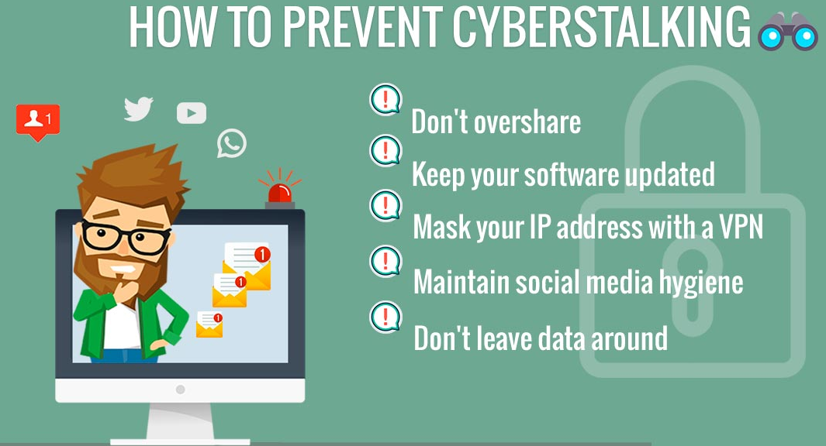
Cyber Stalking
How to Prevent Cyber Stalking:

Slide 27
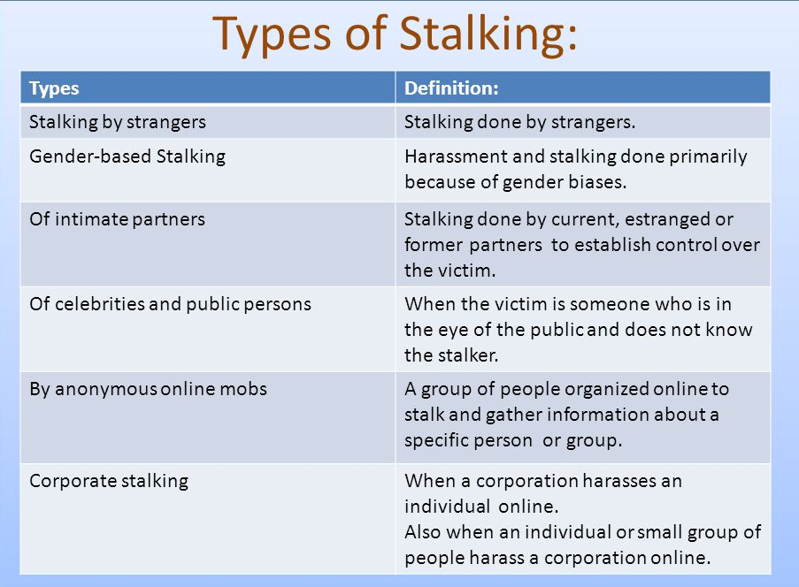
Cyber Stalking

Slide 28
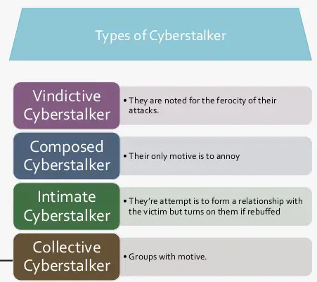
Cyber Stalking

Slide 29
Cyber Stalking
1. Vindictive cyber stalker:
This group is so named due to the ferocity to which they victimize those whom they pursue. They threatened their victims more than any other group and in the majority of cases they actually stalked their target offline. A third of the perpetrators were known to have had a previous criminal record, and two-thirds were known to have victimized others before.
2. Composed cyber stalker:
The composed cyber stalker is so named because it is theorized that their actions are aimed at causing constant annoyance and irritation to their victims. These cyber stalkers were not trying to establish a relationship with the victim but wished to cause distress. These types of perpetrators generally issue threats.

Slide 30
Cyber Stalking
3. Intimate cyber stalker:
This group tried to 'win' the feelings and/or gain the attention of their target. The participants estimated that the computer literacy of these cyber stalkers was of a wider range than any of the previous group. They utilized e-mail, Web discussion groups, and electronic dating sites. They also demonstrated detailed knowledge about victims.
4. Collective cyber stalkers:
This final group is characterized by two or more individuals pursuing victims via information & communication technology. The computer literacy of the persons in this sub-group ranges from fairly high to high. The perpetrators make numerous threats and utilize spamming, mail bombing, identity theft, and intimidating multimedia to harass their victim. This group also try to gain information about their target.

Slide 31
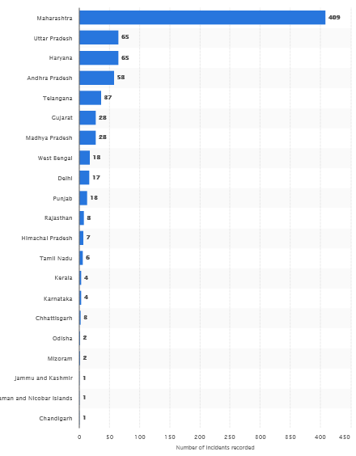
Cyber Stalking
Cases Reported on Cyber stalking:
Cyber stalking and bullying cases
reported in India 2019, by leading
State:
In 2019, the state of Maharashtra
in India had the highest number of
cyber stalking and bullying incidents
against women and children
compared to the rest of the
country, with nearly 409 cases
registered with the authorities.

Slide 32
Real-Life Incident of Cyber stalking
- Last year, Divya Sharma noticed that almost 200 pictures of hers were liked by a random account on Instagram. She dismissed it as harmless until he started posting lewd comments. The Pune-based Archeology student says, “He then started sending me DMs asking if I would like to go on a date with him, which I continued to ignore. Frustrated, he started abusing me, and threatened to forcefully 'make me his wife'.” That’s when Divya lodged an online complaint with the cyber police, got the account in question suspended, and the abuser punished. “No one has the right to threaten you in DMs or comments,” she asserts.
The chairperson of the National Commission for Women, Rekha Sharma at a virtual event told the media that online harassment, including cyber stalking, towards women has increased by 500%, last year.

Slide 33
Real-Life Incident of Cyber stalking
- Seema Khanna (name changed), an embassy employee in New Delhi, wasn’t aware that using the internet will result in an invasion of her privacy. Khanna (32) received a series of emails from a man demanding her to either appear naked for him or pay him Rs 1 lakh in an apparent case of cyber stalking. The woman stated in her statement to Delhi Police that she began receiving these emails in the third week of November 2020.
- Woman threatened by cyber stalker who managed to get her photographs from her mail folder
- In another case, a housewife started receiving obscene calls from across the world after a hacker flashed her details on the internet.

Slide 34
Cyber Cafe & Cyber Crime
- A Cyber cafe is popular locations where young people gather. The young people socialize and also surf the Internet. The fee for using a computer is generally charged as a time-based rate. The first Internet Café was opened in South Korea.
- A number of serious confidentiality breaches are done in cyber cafes. Information left on the hard drive, desktop links and browser history apparently included:
• Personal details
• Financial details
• Company/ Organization’s details
- Internet cafés or public access points of any sort should take steps to work with its customers to protect a user's security.
- Simple steps such as deleting settings on log-out, regular deletion of content on hard drives and clear warnings to users of the risks they are exposing themselves to are simple ways of helping their customers to understand and mitigate the risks of using these systems.

Slide 35
Cyber Cafe & Cyber Crime
WHAT IS MEANING OF CYBER CRIME AND CYBER CAFÉ:
In February 2009 survey, 90% of the audience across eight cities and 3500 cafes were male and in the age group of 15-35 years.
52% were graduates and postgraduates.
Almost 50% were students.
In India, cyber cafes are known to be used for either real or false terrorist communication.
Cyber cafe holds two types of risks:
1. We do not know what programs are installed on the computer like key loggers or spyware.
2. Over the shoulder peeping can enable others to find out your passwords.

Slide 36
Cyber Cafe & Cyber Crime
- Cyber criminals prefer cyber cafes to carry out their activities.
A recent survey conducted in one of the metropolitan cities in India reveals the following facts:
1. Pirated softwares are installed in all the computers.
2. Antivirus was not updated with latest patch.
3. Several cyber cafes have installed “Deep Freeze” to protect computer which helps cyber criminals.
4. Annual Maintenance Contract (AMC) was not found for servicing of the computer.
5. Pornographical websites were not blocked.
6. Cybercafe owner have very less awareness about IT security.
7. Cyber cafe association or State Police do not seem to conduct periodic visits to cyber cafe.

Slide 37
Cyber Cafe & Cyber Crime
SECURITY TIPS FOR CYBER CAFÉ:
- Always Logout–While checking email or logging in for chatting, always click logout/sign out.
- Stay with the computer–While surfing, don’t leave the system unattended for any period of time.
- Clear history and temporary files–Before browsing deselect AutoComplete option. Browser -> Tools -> Internet options -> Content tab.–Tools -> Internet Option -> General Tab -> Temporary Internet Files -> Delete files and then Delete Cookies.
- Avoid online financial transactions–One should avoid online banking, shopping, etc.–Don’t provide sensitive information such as credit card number or bank account details.
- Change Passwords / Virtual Keyboard–Change password after completion of transaction.
- Be alert–One have to be alert for snooping over the shoulder.

Slide 38
Botnets
- The name is a blending of the words “robot” and “network”. In a broad sense, that’s exactly what botnets are: a network of robots used to commit cybercrime. The cyber criminals controlling them are called botmasters.
A botnet is a number of Internet-connected devices, each of which is running one or more bots.
An Internet bot, web robot, robot or simply bot, is a software application that runs automated tasks (scripts) over the Internet. Typically, bots perform tasks that are simple and repetitive much faster than a person could.
OR
A bot is a piece of malware that infects a computer to carry out commands under the remote control of the attacker.

Slide 39
Botnets
- A bot is sometimes called a zombie, and a botnet is sometimes referred to as a zombie army. Conversely, those controlling the botnet are sometimes referred to as bot herders.
A botnet is a network of devices that has been infected with malicious software, such as a virus. Attackers can control a botnet as a group without the owner’s knowledge with the goal of increasing the magnitude of their attacks.
They infect a network of a huge number of interconnected devices. Botnets can be used to perform Distributed Denial-of-Service (DDoS) attacks, steal data, send spam, and allow the attacker to access the device and its connection. The owner can control the botnet using command and control (C&C) software.
The botnet malware typically looks for devices with vulnerable endpoints across the internet, rather than targeting specific individuals, companies or industries.

Slide 40
Botnets
- The objective for creating a botnet is to infect as many connected devices as possible and to use the large-scale computing power and functionality of those devices for automated tasks that generally remain hidden to the users of the devices.
For example, an ad fraud botnet infects a user's PC with malicious software that uses the system's web browsers to divert fraudulent traffic to certain online advertisements. However, to stay concealed, the botnet won't take complete control of the operating system (OS) or the web browser, which would alert the user.
Instead, the botnet may use a small portion of the browser's processes, often running in the background, to send a barely noticeable amount of traffic from the infected device to the targeted ads.

Slide 41
Botnets
Examples of botnet attacks:
Zeus
The Zeus malware, first detected in 2007, is one of the best-known and widely used malware types in the history of information security. Zeus uses a Trojan horse program to infect vulnerable devices. Variants of this malware have been used for various purposes over the years, including spreading CryptoLocker ransomware.
GameOver Zeus
Approximately a year after the original Zeus botnet was disrupted, a new version of the Zeus malware, known as GameOver Zeus, emerged.
Instead of relying on traditional, centralized C&C servers to control bots, GameOver Zeus used a P2P network approach, which initially made the botnet harder for law enforcement and security vendors to pinpoint and disrupt.

Slide 42
Botnets
- Methbot:
An extensive cybercrime operation and ad fraud botnet known as Methbot was revealed in 2016 by cyber security services company White Ops.
According to security researchers, Methbot was generating between $3 million and $5 million in fraudulent ad revenue daily by producing fraudulent clicks for online ads, as well as fake views of video advertisements.

Slide 43
Botnets
Attack Vector:
- In cyber security, an attack vector is a method or pathway used by a hacker to access or penetrates the target system. Hackers steal information, data and money from people and organizations by investigating known attack vectors and attempting to exploit vulnerabilities to gain access to the desired system.
- Once a hacker gains access to an organization's IT infrastructure, they can install a malicious code that allows them to remotely control IT infrastructure, spy on the organization or steal data or other resources.
- It is the technique by means of which unauthorized access can be gained to a device or a network by hackers for wicked purposes. In other words, it is used for assaulting or exploiting a network, computer or device.
- Attack vectors help unauthorized elements to exploit the vulnerabilities in the system or network, including the human elements.

Slide 44
Botnets
- Attack vectors may be exploited by a variety of groups, from a dissatisfied former employee of your organization that wants to disrupt your business to the intelligence service of a foreign government that wants to steal your technology.
- There are also many different known attack vectors that these groups can effectively exploit to gain unauthorized access to your IT infrastructure.
- IT organizations can mitigate against cyber-attacks through a number of different methods, including real-time event detection and response capabilities that neutralize cyber-attacks before they can lead to data loss.
- Examples of attack vectors are email attachments, pop-up windows, deception, chat rooms, viruses and instant messages. In most cases, programming is heavily involved and it is rare to see hardware means involved in an attack vector. Human ignorance or weaknesses are also put to use for engineering attack vectors.

Slide 45
Cyber crime: Mobile and Wireless Devices
- In this modern era, the rising importance of electronic gadgets (i.e., mobile hand-held devices) – which became an integral part of business, providing connectivity with the Internet outside the office – brings many challenges to secure these devices from being a victim of cybercrime.
- In the recent years, the use of laptops, personal digital assistants (PDAs), and mobile phones has grown from limited user communities to widespread desktop replacement and broad deployment.
- By the end of 2008 around 1.5 billion individuals around the world had the Internet access.
- In November 2007, mobile phone users were numbered 3.3 billion, with a growing proportion of those mobile devices enabled for the Internet access.
- The complexity of managing these devices outside the walls of the office is something that the information technology (IT) departments in the organizations need to address.
- Remote connection has extended from fixed location dial-in to wireless-on-the-move, and smart hand-held devices such as PDAs have become networked, converging with mobile phones.

Slide 46
Cyber crime: Mobile and Wireless Devices
- Furthermore, the maturation of the PDA and advancements in cellular phone technology has converted into a new category of mobile phone device: the Smartphone.
- Smartphones combine the best aspects of mobile and wireless technologies and blend them into a useful business tool.
- Thus, the larger and more diverse community of mobile users and their devices increase the demands on the IT function to secure the device, data and connection to the network, keeping control of the corporate assets, while at the same time supporting mobile user productivity.
- Clearly, these technological developments present a new set of security challenges to the global organizations.
- Mobile device security threats are on the rise. In 2014, almost 3.5 million pieces of malware were detected on more than 1 million user devices.

Slide 47
Cyber crime: Mobile and Wireless Devices
Mobile and Wireless Devices Security Threats are:
1) Data Leakage
Mobile apps are often the cause of unintentional data leakage. For example, “riskware” apps pose a real problem for mobile users who grant them broad permissions, but don’t always check security. These are typically free apps found in official app stores that perform as advertised, but also send personal—and potentially corporate—data to a remote server, where it is mined by advertisers, and sometimes, by cybercriminals.
2) Unsecured Wi-Fi
No one wants to burn through their cellular data when wireless hot spots are available—but free Wi-Fi networks are usually unsecured. in fact, three British politicians who agreed to be part of a free wireless security experiment were easily hacked by technology experts. Their social media, PayPal and even their conversations were compromised.

Slide 48
Cyber crime: Mobile and Wireless Devices
3) Network Spoofing
Network spoofing is when hackers set up fake access points—connections that look like Wi-Fi networks, but are actually traps—in high-traffic public locations such as coffee shops, libraries and airports. Cybercriminals give the access points common names like “Free Airport Wi-Fi” or “Coffeehouse” to encourage users to connect.
4) Phishing Attacks
Because mobile devices are always powered-on, they are the front lines of most phishing attack. Mobile users are more vulnerable because they are often monitoring their email in real-time, opening and reading emails when they are received. Never click on unfamiliar email links. And if the matter isn’t urgent, then let the response or action items wait until you’re at your computer.

Slide 49
Cyber crime: Mobile and Wireless Devices
5) Spyware
Although many mobile users worry about malware sending data streams back to cybercriminals, there’s a key threat closer to home: Spyware. In many cases, it’s not malware from unknown attackers that users should be worried about, but rather spyware installed by spouses, coworkers or employers to keep track of their whereabouts and activity. Also known as stalkerware, many of these apps are designed to be loaded on the target’s device without their consent or knowledge.

Slide 50
Cyber crime: Mobile and Wireless Devices
Proliferation (Growth) of Mobile and Wireless Devices:
- Today, incredible advances are being made for mobile devices.
- The trend is for smaller devices and more processing power.
- A few years ago, the choice was between a wireless phone and a simple PDA.
- Now the buyers have a choice between high-end PDAs with integrated wireless modems and small phones with wireless Web-browsing capabilities.
- A simple hand-held mobile device provides enough computing power to run small applications, play games and music, and make voice calls.
- The term “mobile device” includes many products like mobile computing devices, wireless computing devices and hand-held devices.

Slide 51
Cyber crime: Mobile and Wireless Devices
Trends in Mobility:
- Mobile computing is moving into a new era, third generation (3G), which promises greater variety in applications and have highly improved usability as well as speedier networking.
- “iPhone” from Apple and Google-led “Android” phones are the best examples of this trend and there are plenty of other developments that point in this direction.
- This smart mobile technology is rapidly gaining popularity and the attackers (hackers and crackers) are among its biggest fans.
- It is worth noting the trends in mobile computing; this will help readers to realize the seriousness of cyber security issues in the mobile computing domain.

Slide 52
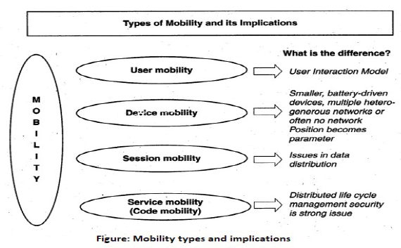
Cyber crime: Mobile and Wireless Devices
Trends in Mobility: - Figure shows the different types of mobility and their implications.

Slide 53
Credit Card Frauds in Mobile and Wireless Computing Era
- In this modern era, the rising importance of electronic gadgets – which became an integral part of business, providing connectivity with the internet outside the office – brings many challenges to secure these devices from being a victim of cyber-crime.
- These are new trends in cybercrime that are coming up with mobile computing – mobile commerce (M- Commerce) and mobile banking (M-Banking).
- Credit card frauds are now becoming commonplace given the ever- increasing power and the ever-reducing prices of the mobile hand-held devices, factors that result in easy availability of these gadgets to almost anyone.
- Mobile credit card transactions are now very common; new technologies combine low- cost mobile phone technologies with the capabilities of a point-of-sale (POS) terminal.
- Today belongs to “mobile computing,” that is, anywhere anytime computing.

Slide 54
Credit Card Frauds in Mobile and Wireless Computing Era
- The developments in wireless technology have fuelled this new mode of working for white collar workers.
- Wireless credit card processing is a very desirable system, because it allows businesses to process transactions from mobile locations quickly, efficiently and professionally.
- It is most often used by businesses that operate mainly in a mobile environment.
- Credit card companies, normally, do a good job of helping consumers resolve identity (ID) theft problems once they occur. But they could reduce ID fraud even more if they give consumers better tools to monitor their accounts and limit high-risk transactions.
- Credit card (or debit card) fraud is a form of identity theft that involves an unauthorized taking of another’s credit card information for the purpose of charging purchases to the account or removing funds from it.

Slide 55
Credit Card Frauds in Mobile and Wireless Computing Era
The basic flow is as follows:
1. Merchant sends a transaction to bank;
2. The bank transmits the request to the authorized cardholder
3. The cardholder approves or rejects (password protected);
4. The bank/merchant is notified;
5. The credit card transaction is completed.
Tips to Prevent Credit Card Frauds:
Do’s
1. Put your signature on the card immediately upon its receipt.
2. Make the photocopy of both the sides of your card and preserve it at a safe place to remember the card number, expiration date in case of loss of card.
3. Change the default personal identification number (PIN) received from the bank before doing any transaction.

Slide 56
Credit Card Frauds in Mobile and Wireless Computing Era
4. Always carry the details about contact numbers of your bank in case of loss of your card.
5. Carry your cards in a separate pouch/card holder than your wallet.
6. Keep an eye on your card during the transaction, and ensure to get it back immediately.
7. Preserve all the receipts to compare with credit card invoice.
8. Reconcile your monthly invoice/statement with your receipts.
9. Report immediately any discrepancy observed in the monthly invoice/statement.
10. Destroy all the receipts after reconciling it with the monthly invoice/statement.
11. Inform your bank in advance, about any change in your contact details such as home address, cell phone number and E-Mail address.
12. Ensure the legitimacy of the website before providing any of your card details.
13. Report the loss of the card immediately in your bank and at the police station, if necessary

Slide 57
Credit Card Frauds in Mobile and Wireless Computing Era
Don’ts:
1. Store your card number and PINs in your cell.
2. Lend your cards to anyone.
3. Leave cards or transaction receipts lying around.
4. Sign a blank receipt (if the transaction details are not legible, ask for another receipt to ensure the amount instead of trusting the seller).
5. Write your card number/PIN on a postcard or the outside of an envelope.
6. Give out immediately your account number over the phone (unless you are calling to a company/to your bank).
7. Destroy credit card receipts by simply dropping into garbage box/dustbin

Slide 58
Credit Card Frauds in Mobile and Wireless Computing Era
Types of Credit Card Fraud:
1. PoS Fraud:
In this type of fraud, small skimming devices are attached to normal Point-of-Sale (PoS) devices to hack your data. These devices scan and store the card information while the customer completes a swipe transaction. Usually, this involves a merchant or store employee who shares these details with malicious actors. Similar attachments may also be fastened on to ATM card slots to clone card information, while a camera is secretly placed over the keypad to capture your PIN.
What you should do:
Watch out for suspicious devices connected to PoS units. Always shake or jiggle the slot to see if a cloning attachment comes loose and always cover the keypad with your other hand while entering the PIN.

Slide 59
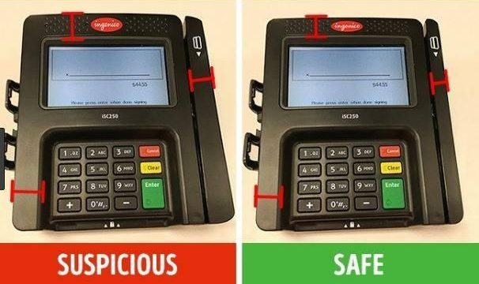
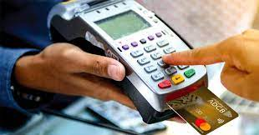
Credit Card Frauds in Mobile and Wireless Computing Era
On NFC (Near Field Communication) enabled PoS machines, you can simply tap the card to pay. This significantly reduces the skimming risk. Further, transactions lesser than Rs 2000 can be completed without the hassle of keying in the PIN. This will also reduce the chance of your PIN getting captured.

Slide 60
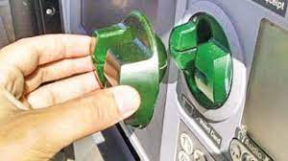
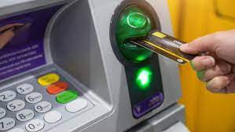
Credit Card Frauds in Mobile and Wireless Computing Era
Skimming device at ATM:

Slide 61
Credit Card Frauds in Mobile and Wireless Computing Era
2. Phishing and Vishing:
These involve impersonating official communication from the bank which in turns acts as a bait for you to click on false links. This will usually take you to websites that look authentic. Once you enter your card details on these fake links, fraudsters can access the details and use them for their benefit. Another version is when fraudsters impersonate bank officials on phone calls, asking you to share an OTP to ‘verify your card’ or ‘avail the reward points’ or ‘extend the validity of your reward points.’
What you should do:
Always verify the URL and never click suspicious links. Always use your bank’s official website for any online transaction or contact your bank’s official helpline numbers directly. Also, report the telephone/mobile number from where you received fake calls to your bank.

Slide 62
Credit Card Frauds in Mobile and Wireless Computing Era
3. Keystroke logging:
Today, since most financial transactions are online, hackers have started relying on keystroke logging through malicious software to grab credit card details. This usually begins after you have clicked on a suspicious link and unknowingly installed malware on your system. The software records every key pressed on the system, eventually stealing card details, PIN and more.
What you should do:
Use the virtual keyboard available in your operating system. Again, never click suspicious links that may install applications from untrustworthy sources. Use reliable antivirus software on your system for an added layer of protection.

Slide 63
Credit Card Frauds in Mobile and Wireless Computing Era
4. Application fraud:
This is a type of identity theft where fraudulent actors impersonate a genuine customer by using their stolen or counterfeited documents to obtain a credit card. While this might be detected after thorough background checks, if carried out, this will allow criminals to use a valid credit card with a false paper trail. A similar type of fraud involves taking over a valid credit card account by posing as the customer using a similar fake paper trail.
What you should do:
Keep track of all your documents and destroy redundant copies before disposal to protect yourself from these types of frauds.

Slide 64
Credit Card Frauds in Mobile and Wireless Computing Era
5. Theft or loss of card:
If your physical credit card gets stolen or misplaced, there are chances it could be misused. There are precautions you can take in advance as well as safeguards you can put in place even after it is stolen.
Precautions to take:
• Always memorize your CVV and scratch it off the card to avoid misuse in case it is stolen or misplaced.
• Set up alerts for all transactions so that you can be notified for any unwanted purchases on your card.
• Use credit card protection services

Slide 65
Security Challenges Posed by Mobile Devices
Mobility brings two main challenges to cyber security:
1. On the hand-held devices, information is being taken outside the physically controlled environment and
2. Remote access back to the protected environment is being granted.
- Perceptions of the organizations to these cyber security challenges are important in devising appropriate security operating procedure.
- As the number of mobile device users increases, two challenges are presented:
1. At the device level called “microchallenges” and
2. At the organizational level called “macrochallenges.”

Slide 66
Security Challenges Posed by Mobile Devices
Mobile Device Information Security Risks:
1. Unsafe apps:
Although the mobile phone vendors try to ensure app security through requiring apps to be signed to be downloaded from the official app stores, misuse of certificates means that even apps downloaded from vendor stores or enterprise sites aren’t guaranteed to be free from malware. Even legitimate apps often request more permission than needed to perform their function, which can expose more data than necessary.
2. Unsafe operating systems:
Large numbers of mobile devices are not kept up to date with operating system releases. Out of date operating systems mean devices are vulnerable to security threats that are patched in the later versions.

Slide 67
Security Challenges Posed by Mobile Devices
3. Unsafe devices:
When user jailbreak or root devices, they work around the built-in restrictions of the device. While users feel that jailbreaking gives them freedom and more access to the device’s capabilities, jailbreaking also eliminates many controls that provide security.
4. Unsafe connections:
Users often rely on public Wi-Fi to stay connected when they work outside the office. These unsecured Wi-Fi networks can allow malware to be installed on devices or eavesdroppers to intercept data.
5. Lost devices:
Portable devices are easily lost or stolen. When an employee loses physical control of their mobile device, they also lose control of the data on that device. If the device isn’t appropriately protected with passwords and encryption, any data on that device may be exposed.

Slide 68
Security Challenges Posed by Mobile Devices
6. Uncontrollable users:
No matter how well you publicize your safe mobile computing policies; there will be employees who find them too inconvenient to follow. Organizations need tools to enforce policies rather than relying on employees’ good will.
7. Lack of monitoring:
The large number of mobile devices used in an organization makes monitoring and managing them difficult. It isn’t easy to understand the status of all mobile devices, users, and applications at a glance.
8. Variety of devices:
There’s no single standard for mobile devices, especially when you allow BYOD rather than supplying the devices. Because of the variety of devices and operating systems, it’s difficult to apply controls consistently to ensure the safety of all of them.

Slide 69
Security Challenges Posed by Mobile Devices
9. Mobile Viruses:
- A mobile virus is similar to a computer virus that targets mobile phone data or applications/software installed in it.
- Virus attacks on mobile devices are no longer an exception or proof-of-concept nowadays.
- In total, 40 mobile virus families and more than 300(+) mobile viruses have been identified.
- First mobile virus was identified in 2004 and it was the beginning to understand that mobile devices can act as vectors to enter the computer network.
- Mobile viruses get spread through two dominant communication protocols – Bluetooth and MMS.
- Bluetooth virus can easily spread within a distance of 10–30 m, through Bluetooth- activated phones
- MMS virus can send a copy of itself to all mobile users whose numbers are available in the infected mobile phone’s address book.

Slide 70
Security Challenges Posed by Mobile Devices
10. Mishing:
- Mishing is a combination of mobile and Phishing.
- Mishing attacks are attempted using mobile phone technology.
- M-Commerce is fast becoming a part of everyday life. If you use your mobile phone for purchasing goods/services and for banking, you could be more vulnerable to a Mishing scam.
- A typical Mishing attacker uses call termed as Vishing or message (SMS) known as Smishing.
- Attacker will pretend to be an employee from your bank or another organization and will claim a need for your personal details.
- Attackers are very creative and they would try to convince you with different reasons why they need this information from you.

Slide 71
Security Challenges Posed by Mobile Devices
11. Vishing:
- Vishing is the criminal practice of using social engineering over the telephone system, most often using features facilitated by VoIP, to gain access to personal and financial information from the public for the purpose of financial reward.
- The term is a combination of V – voice and Phishing.
- Vishing is usually used to steal credit card numbers or other related data used in ID theft schemes from individuals.
- The most profitable uses of the information gained through a Vishing attack include:
1. ID theft; 2. purchasing luxury goods and services; 3. transferring money/funds;
4. monitoring the victims’ bank accounts; 5. making applications for loans and credit cards.

Slide 72
Authentication Service Security
- An authentication service is a mechanism, analogous to the use of passwords on time-sharing systems, for the secure authentication of the identity of network clients by servers and vice versa.
- Modern computer systems provide service to multiple users and require the ability to accurately identify the user making a request.
- Password based authentication is not suitable for use on computer network – as it can be easily intercepted by the eavesdropper to impersonate the user.
- No malicious code can impersonate (imitate) the service provider to trick the device into doing something it does not mean to. Thus, the networks also play a crucial role in security of mobile devices.
- Some eminent kinds of attacks to which mobile devices are subjected to are: push attacks, pull attacks and crash attacks.

Slide 73
Authentication Service Security
There are 2 components of security in mobile computing:
1. Security of Devices: – A secure network access involves mutual authentication between the device and the base station or web servers. So that authenticated devices can be connected to the network to get requested services. In this regard Authentication Service Security is important due to typical attacks on mobile devices through WAN:
DoS attacks
Traffic analysis
Eavesdropping
Man-in-the-middle attacks
2. Security in network: – Security measures in this regard come from
Wireless Application Protocol (WAP)
Use of Virtual Private Networks (VPN)
MAC address filtering

Slide 74
Authentication Service Security
Different types of Security:
1. Cryptographic Security for Mobile Devices:
- Cryptographically Generated Addresses (CGA) is Internet Protocol version 6 (IPv6) that addresses up to 64 address bits that are generated by hashing owner’s public-key address.
- The address the owner uses is the corresponding private key to assert address ownership and to sign messages sent from the address without a public-key infrastructure (PKI) or other security infrastructure.
- Deployment of PKI provides many benefits for users to secure their financial transactions initiated from mobile devices.

Slide 75
Authentication Service Security
2. LDAP (Lightweight Directory Access Protocol) Security for Hand-Held Mobile Computing Devices:
- LDAP is a software protocol for enabling anyone to locate individuals, organizations and other resources such as files and devices on the network (i.e., on the public Internet or on the organization’s Intranet).
- In a network, a directory tells you where an entity is located in the network.
- LDAP is a light weight (smaller Attacker Launches blended attack over rogue ad hoc network (802.11, Bluetooth, infrared) amount of code) version of Directory Access Protocol (DAP) because it does not include security features in its initial version.

Slide 76
Attacks on Mobile/Cell Phones
1. Mobile Phone Theft:
- Mobile phones have become an integral part of everybody’s life and the mobile phone has transformed from being a luxury to a bare necessity.
- Theft of mobile phones has risen dramatically over the past few years.
- Since huge section of working population in India use public transport, major locations where theft occurs are bus stops, railway stations and traffic signals.
- Many Insurance Companies have stopped offering Mobile Theft Insurance due to a large number of false claims.
- When anyone loses his/her mobile phone, more than anything “Contact List” and “Personally Identifiable Information (PII)”, that really matter, are lost.
- Another reason is increasing demand for Wi-Fi zones in the metropolitans and extensive usage of cell phones in the youths with lack of awareness/knowledge about the vulnerabilities of the technology.

Slide 77
Attacks on Mobile/Cell Phones
2. Mobile Viruses:
- One might have just thought that his/her cell phone is much safer than a PC that is very often attacked by viruses; however, criminals made this thought as false statement.
- A mobile virus is similar to a computer virus that targets mobile phone data or applications/software installed in it.
- Virus attacks on mobile devices are no longer an exception or proof-of-concept nowadays.
- In total, 40 mobile virus families and more than 300(+) mobile viruses have been identified.
First mobile virus was identified in 2004 and it was the beginning to understand that mobile devices can act as vectors to enter the computer network.
- Mobile viruses get spread through two dominant communication protocols – Bluetooth and MMS.
- Bluetooth virus can easily spread within a distance of 10–30 m, through Bluetooth- activated phones
- MMS virus can send a copy of itself to all mobile users whose numbers are available in the infected mobile phone’s address book.

Slide 78
Attacks on Mobile/Cell Phones
3. Mishing:
- Mishing is a combination of mobile and Phishing.
- Mishing attacks are attempted using mobile phone technology.
- M-Commerce is fast becoming a part of everyday life. If you use your mobile phone for purchasing goods/services and for banking, you could be more vulnerable to a Mishing scam.
- A typical Mishing attacker uses call termed as Vishing or message (SMS) known as Smishing.
- Attacker will pretend to be an employee from your bank or another organization and will claim a need for your personal details.
- Attackers are very creative and they would try to convince you with different reasons why they need this information from you.

Slide 79
Attacks on Mobile/Cell Phones
4. Vishing:
- Vishing is the criminal practice of using social engineering over the telephone system, most often using features facilitated by VoIP, to gain access to personal and financial information from the public for the purpose of financial reward.
- The term is a combination of V – voice and Phishing.
- Vishing is usually used to steal credit card numbers or other related data used in ID theft schemes from individuals.
- The most profitable uses of the information gained through a Vishing attack include:
1. ID theft; 2. Purchasing luxury goods and services 3. Transferring money/funds;
4. Monitoring the victims’ bank accounts; 5. Making applications for loans and credit cards

Slide 80
Attacks on Mobile/Cell Phones
5. Smishing:
- Smishing is a criminal offense conducted by using social engineering techniques similar to Phishing.
- The name is derived from “SMS PHISHING.”
- SMS can be abused by using different methods and techniques other than information gathering under cybercrime.
- Smishing uses cell phone text messages to deliver a lure message to get the victim to reveal his/her PI.
- The popular technique to “hook” (method used to actually “capture” your information) the victim is either provide a phone number to force the victim to call or provide a website URL to force the victim to access the URL, wherein, the victim gets connected with bogus website (i.e., duplicate but fake site created by the criminal) and submits his/her PI.
- Smishing works in the similar pattern as Vishing.

Slide 81
Attacks on Mobile/Cell Phones
6. Hacking Bluetooth:
- Bluetooth is an open wireless technology standard used for communication (i.e., exchanging data) over short distances (i.e., using short length radio waves) between fixed and/or mobile device.
- Bluetooth is a short-range wireless communication service/technology that uses the 2.4- GHz frequency range for its transmission/communication.
- The older standard – Bluetooth 1.0 has a maximum transfer speed of 1 Mbps (megabit per second) compared with 3 Mbps by Bluetooth 2.0.
- When Bluetooth is enabled on a device, it essentially broadcasts “I’m here, and I’m able to connect” to any other Bluetooth-based device within range.
- This makes Bluetooth use simple and straightforward, and it also makes easier to identify the target for attackers.

Slide 82
Attacks on Mobile/Cell Phones
- The attacker installs special software [Bluetooth hacking tools] on a laptop and then installs a Bluetooth antenna.
- Whenever an attacker moves around public places, the software installed on laptop constantly scans the nearby surroundings of the hacker for active Bluetooth connections. Once the software tool used by the attacker finds and connects to a vulnerable Bluetooth- enabled cell phone, it can do things like download address book information, photos, calendars, SIM card details, make long-distance phone calls using the hacked device, bug phone calls and much more.
Bluejacking, Bluesnarfing, Bluebugging and Car Whisperer are common attacks that have emerged as Bluetooth-specific security issues.
1. Bluejacking:
It means Bluetooth + Jacking where Jacking is short name for hijack – act of taking over something. Bluejacking is sending unsolicited messages over Bluetooth to Bluetooth-enabled devices such as mobile phones, PDAs or computers (within 10-m radius), Bluejacking is harmless, as bluejacked users generally do not understand what has happened and hence they may think that their phone is malfunctioning.

Slide 83
Attacks on Mobile/Cell Phones
2. Bluesnarfing:
It is the unauthorized access from a wireless device through a Bluetooth connection between cell phones, PDAs and computers. This enables the attacker to access a calendar, contact list,
SMS and E-Mails as well as enable attackers to copy pictures and private videos.
3. Bluebugging:
It allows attackers to remotely access a user’s phone and use its features without user’s attention.
4. Car Whisperer:
It is a piece of software that allows attackers to send audio to and receive audio from a Bluetooth-enabled car stereo.

Slide 84


